Slide 1
MAILX
Team 11

Slide 2
Solution Description
Extracting the raw files(emails) and storing that in DB.
Created a machine learning model, that predict the category(nature of email) for each email.
Developed the Single page UI Application to see the processed email report using Angular4.
Used CountVectorizer and TfidTransformer model to train the model.
User can add labels(Metadata) to any emails and later model will get retrain basic of that.

Slide 3
Solution Architecture
Raw Data(Emails)
Extract Data / Applied ML
Storing in MySQL
UI Application

Slide 4
High Level Application Architecture
Server
MySQL
ML
API
UI

Slide 5
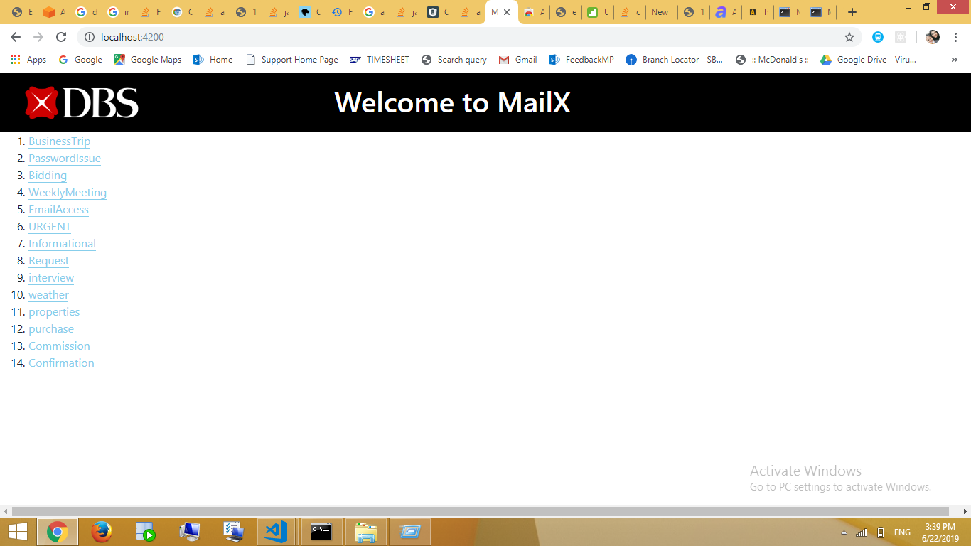
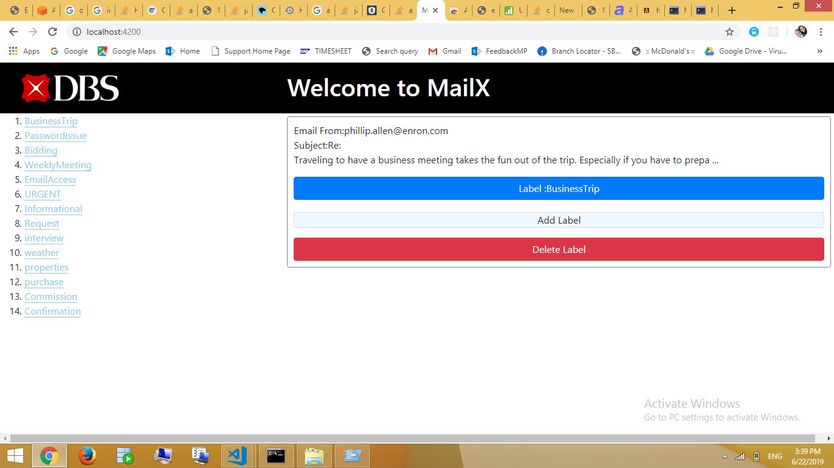
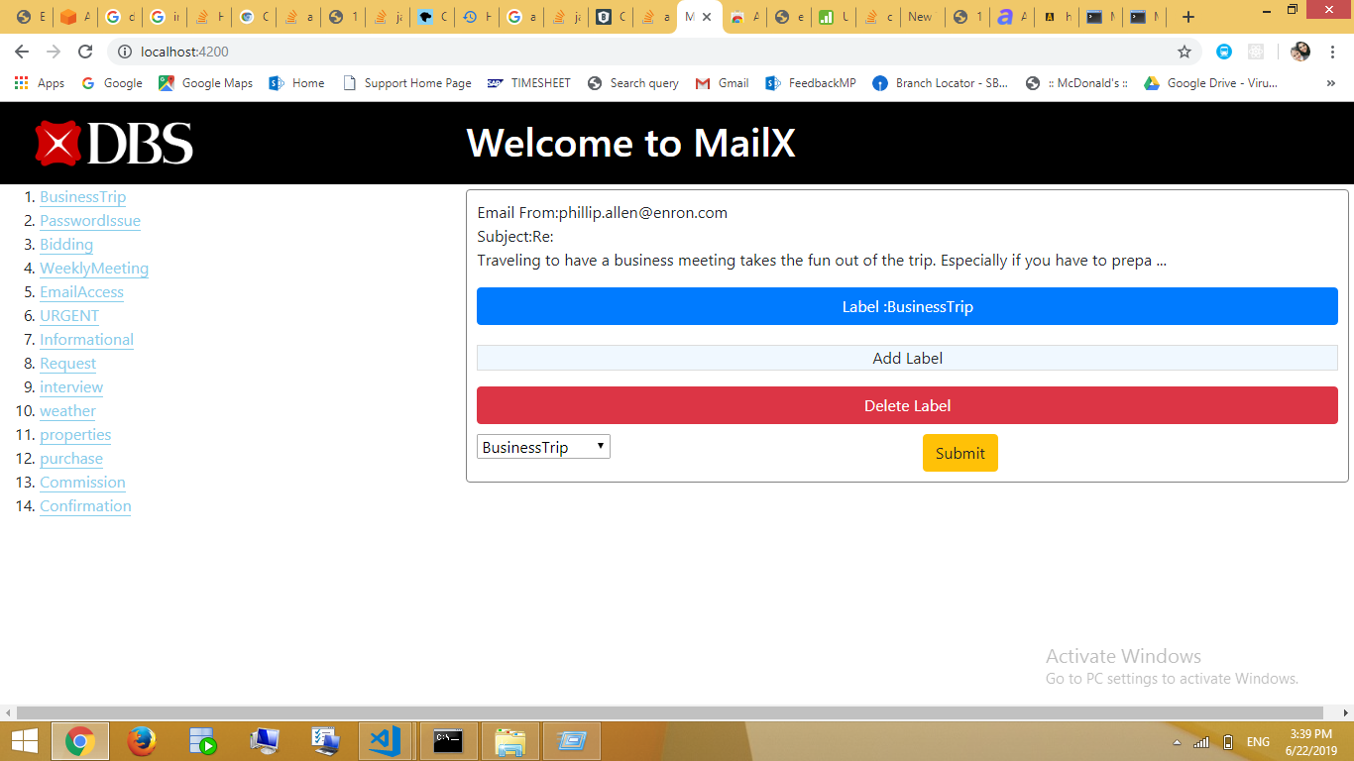
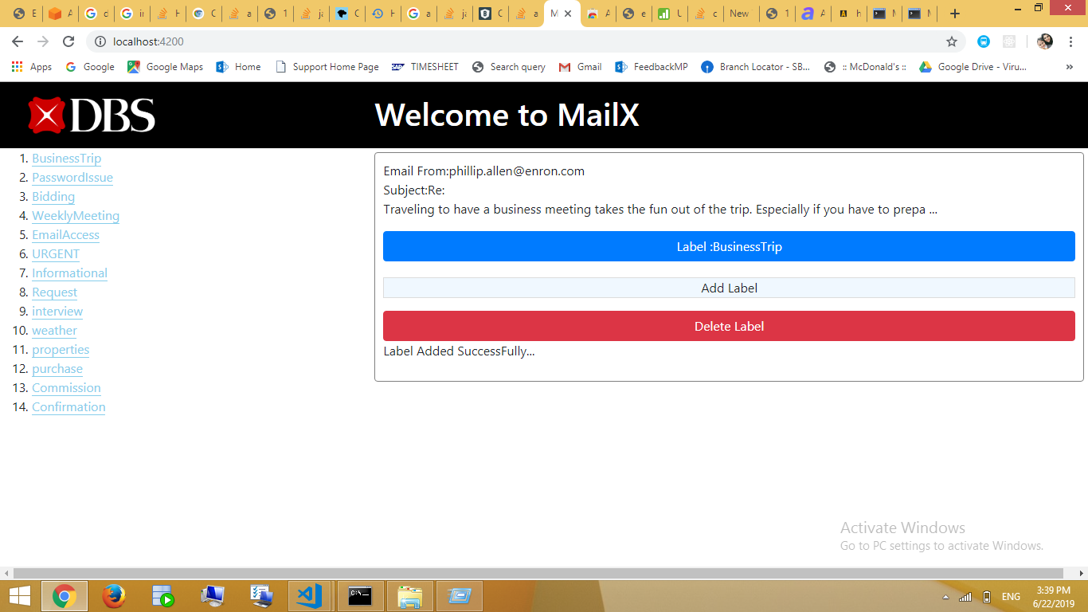
Current application screenshot

Slide 6
Future Enhancement
Test the model me high volume of data(emails)
Enhance the model to get more dynamic categories.
Create a backend jobs to train the model based on user added/updated categories.
Upgrade the UI for more user friendly.
Add the test plan to test functionality and performance of the applications.

